Slide 1
Predicting Player Values
Umer Ayub

Slide 2
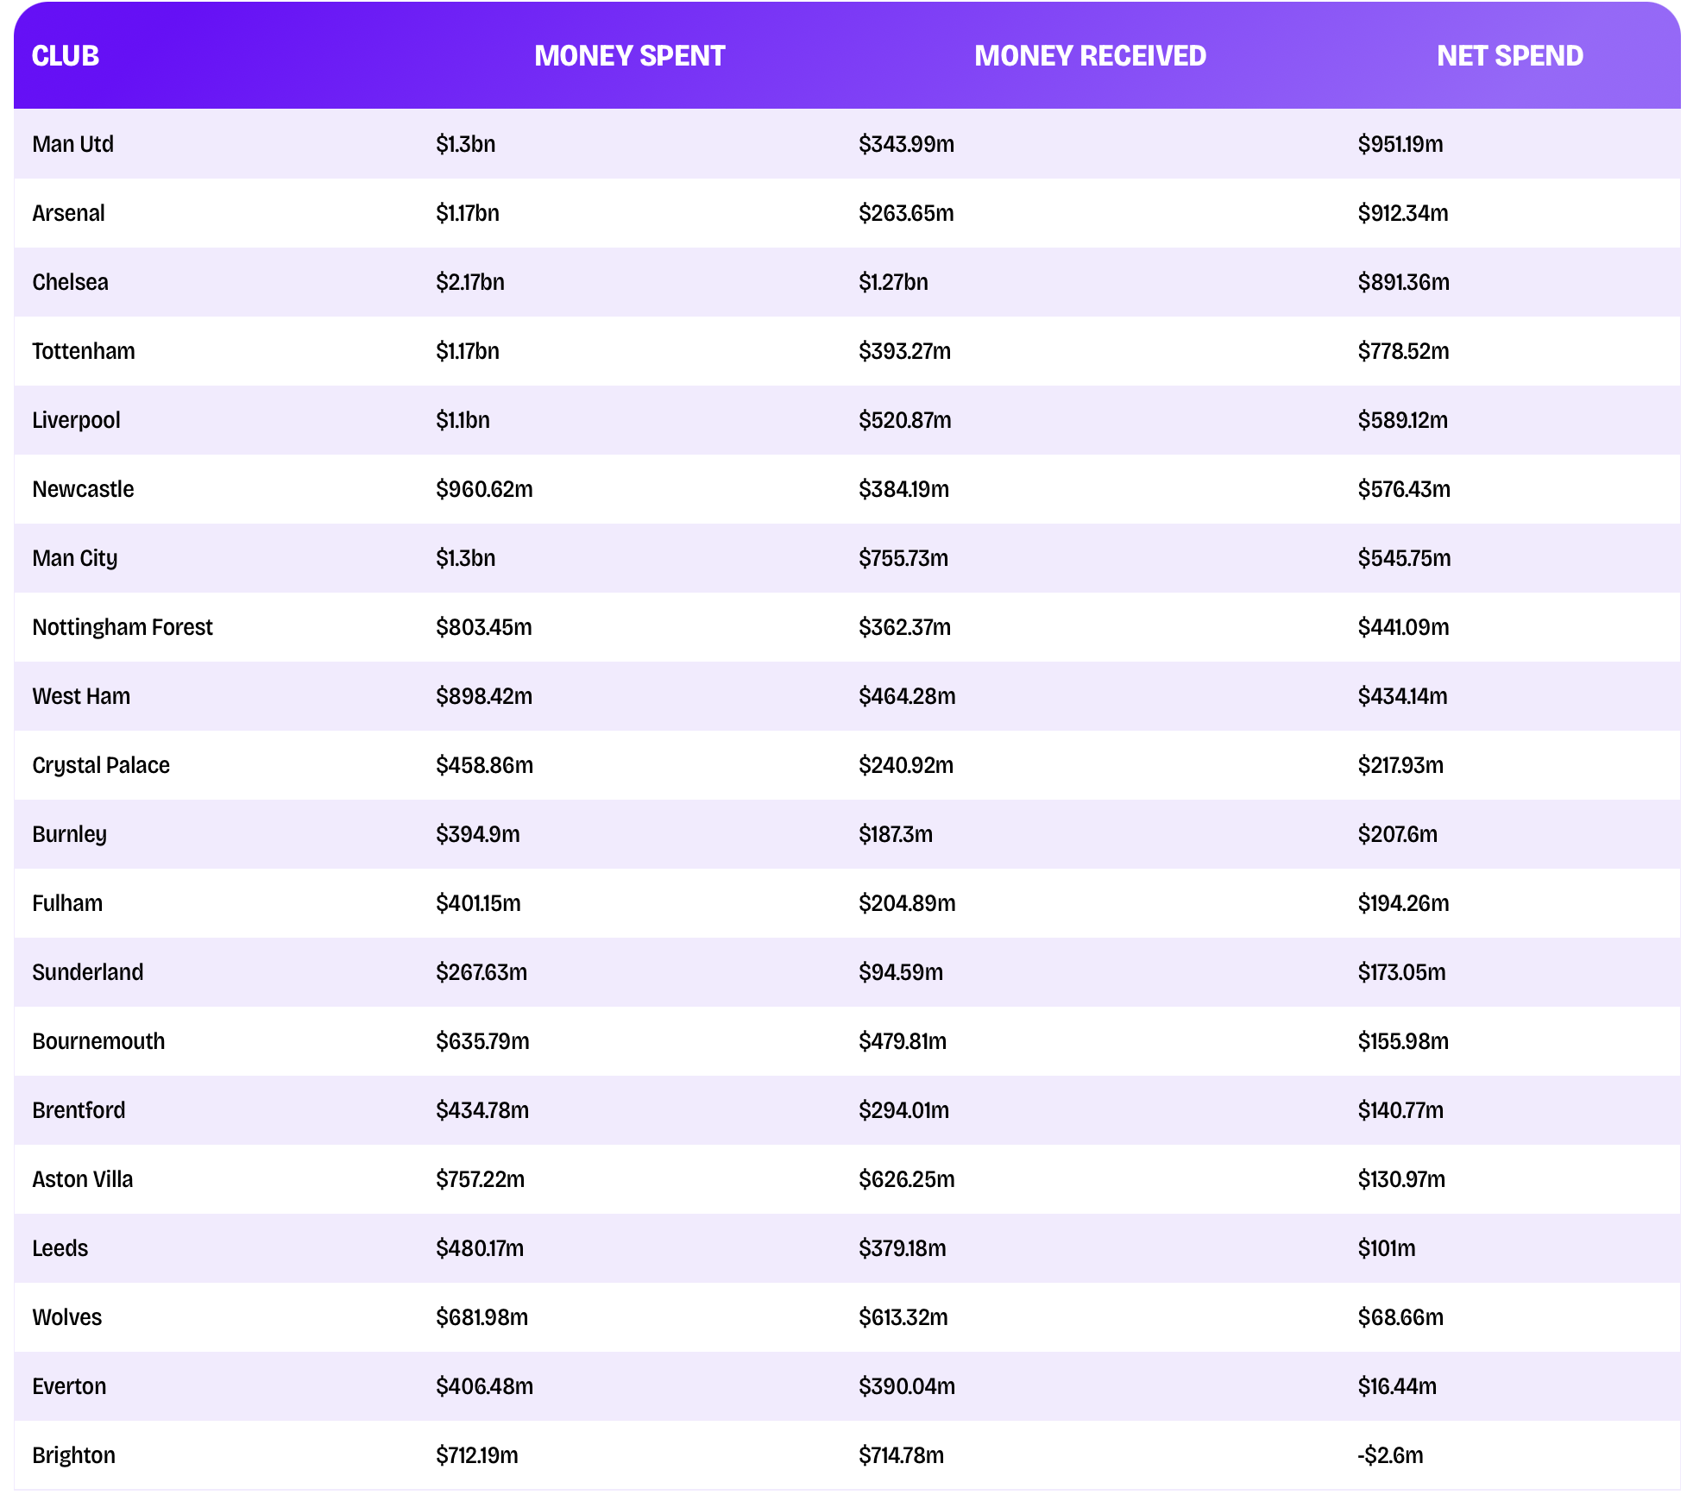
Why does it matter
Players in soccer have about to be bought and sold going up to tens of millions of dollars.
Spending the wrong amount on players leads to clubs creating debt and teams with years of history disappearing in obscurity

Slide 3
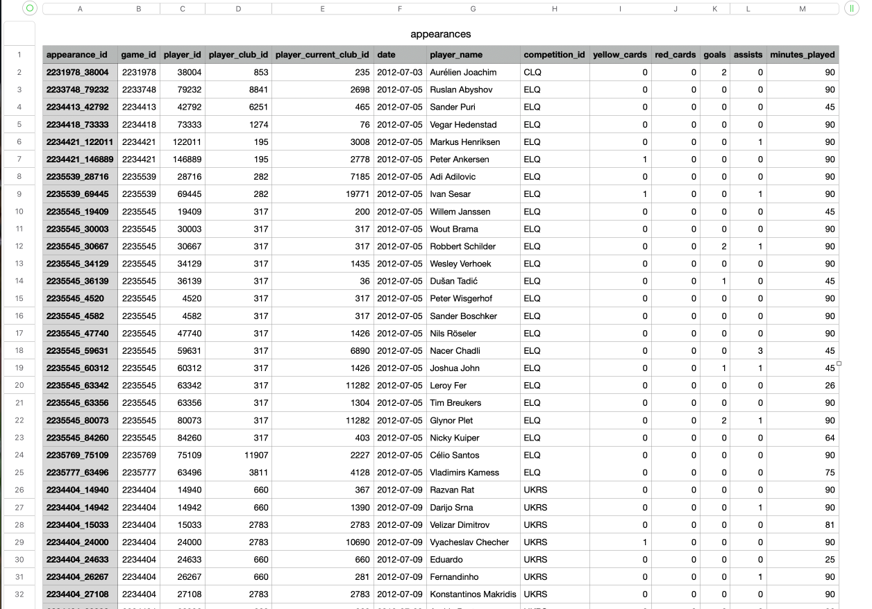
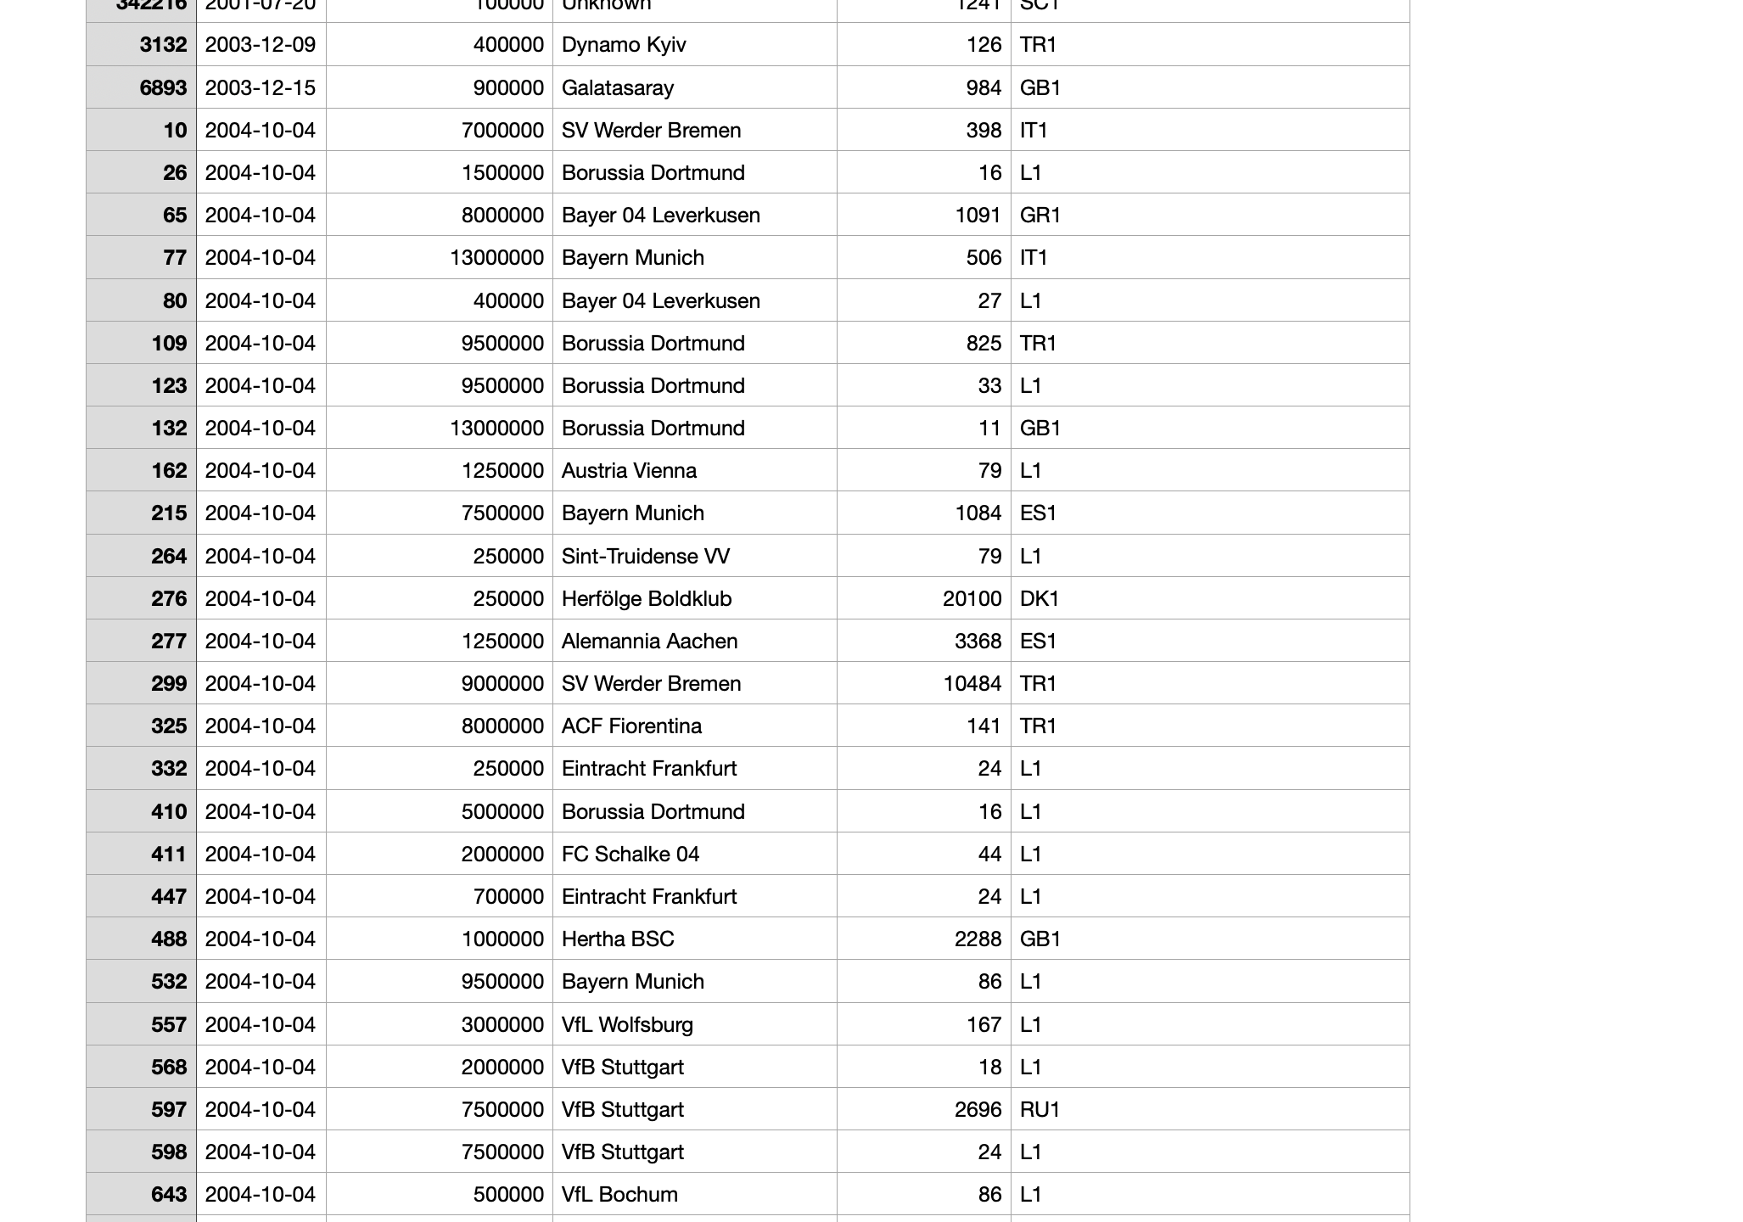
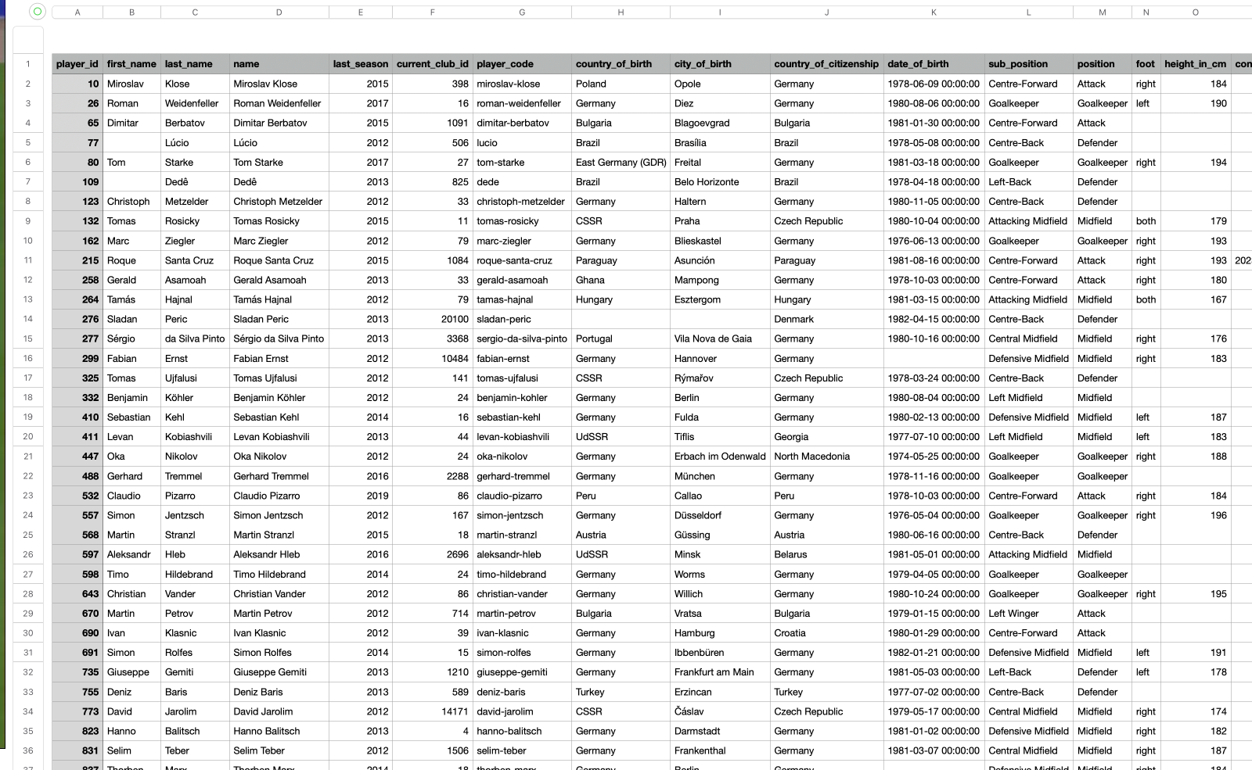
Dataset
This dataset comes from Kaggle with the dataset being from Transfermarkt
3 datasets are being used for this to have the proper features for this project
3 datasets with a total of 45 features originally
Appearances
Player Valuations
Players

Slide 4
Feature Engineering
Features
Position
Position
Foot
Height in cm
Age
Current Domestic Competition
Goals per Game
Assists per Game
Minutes per Game
Yellow cards per Game
Total Appearances
Combined all datasets into one main dataset
One Hot Encoding for all categorical values
Condensed the features into 11 features to predict market value

Slide 5
Models
Baseline Model
Simple model finding the average mean market values of players in the dataset
Linear Regression
This model is used to assume the features being used have a linear relationship to try and predict the market value
Decision Tree
This model is being used as

Slide 6
Next Steps
Finish the remaining models
Test all 3 models after adjusting for skewness
Adding more features to improve the accuracy score

Slide 7
The End
Any Questions?

